Slide 1

Predictive Analysis of Cuisines from Ingredients
Friday, April 29th , 2016
Rajesh Reddy Vanga
Samarth Belachikatte Shamanna

Slide 2
What’s for Lunch?
Objective
Predicting the Cuisines of food from the ingredients,
using different algorithms for varying efficiencies.

Slide 3
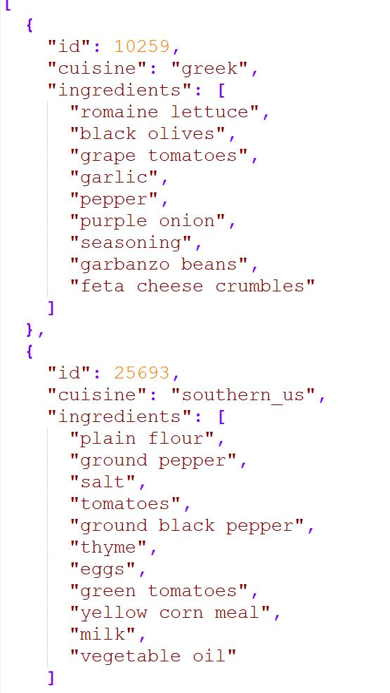
Train_Json
Train Records: 39774

Slide 4
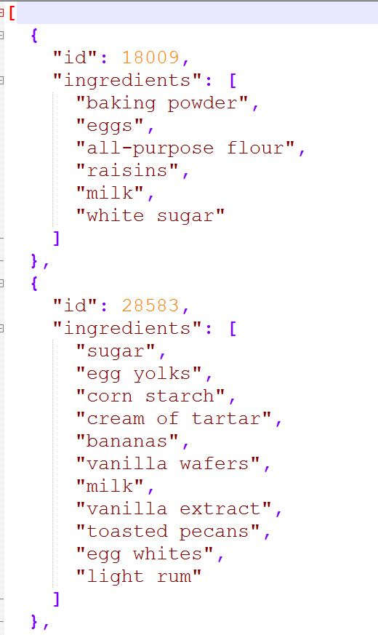
Test_Json
Test Records: 9944

Slide 5
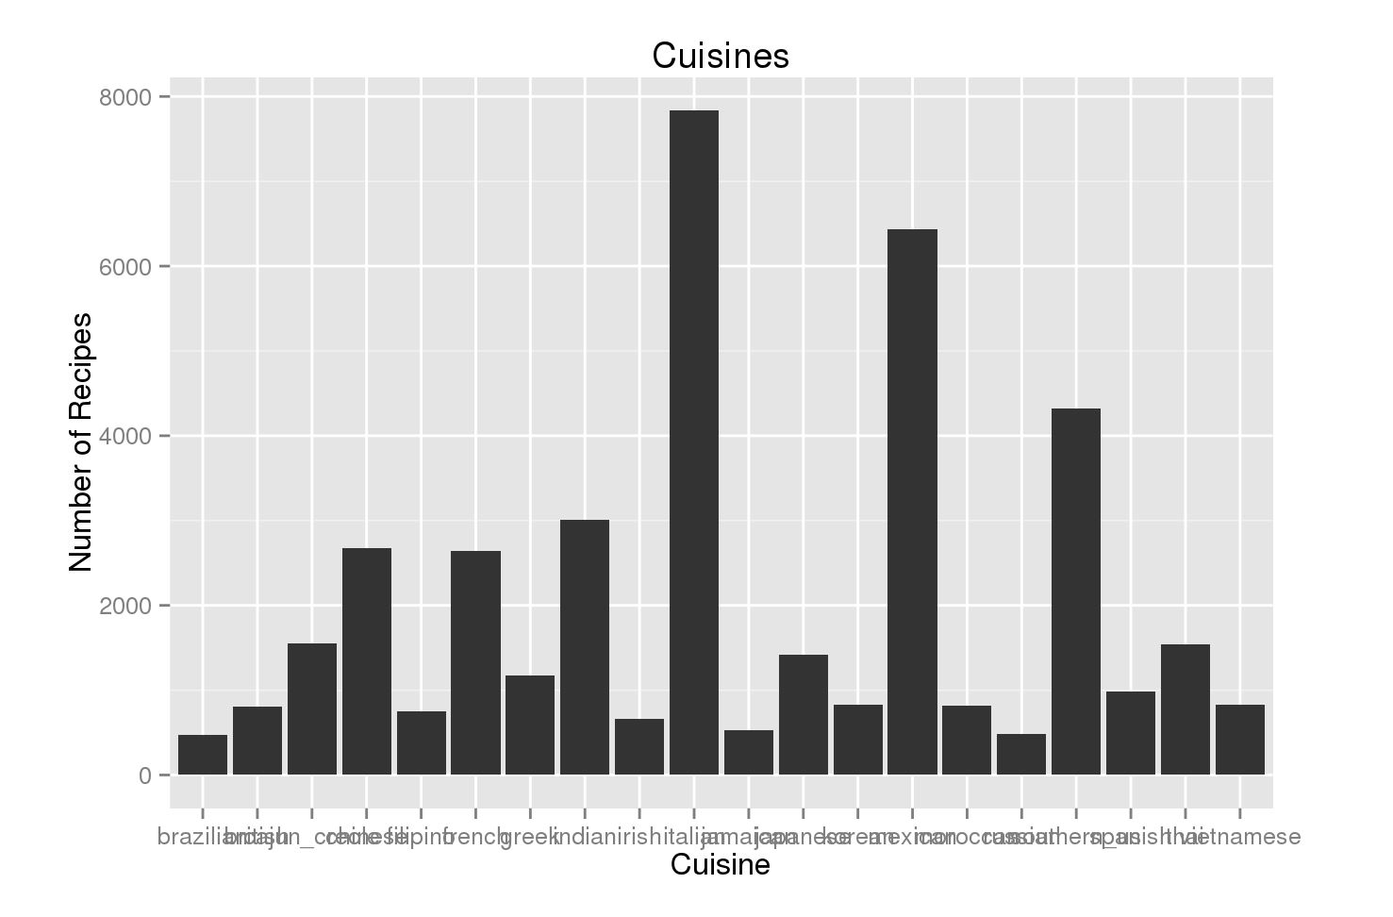

Slide 6
Algorithms Used
CART (RPART)
MultiClass: SoftMax (classifier) – Xgboost

Slide 7
Language
R
Strong Open Source Community
Plotting
Tons of available packages to choose from

Slide 8
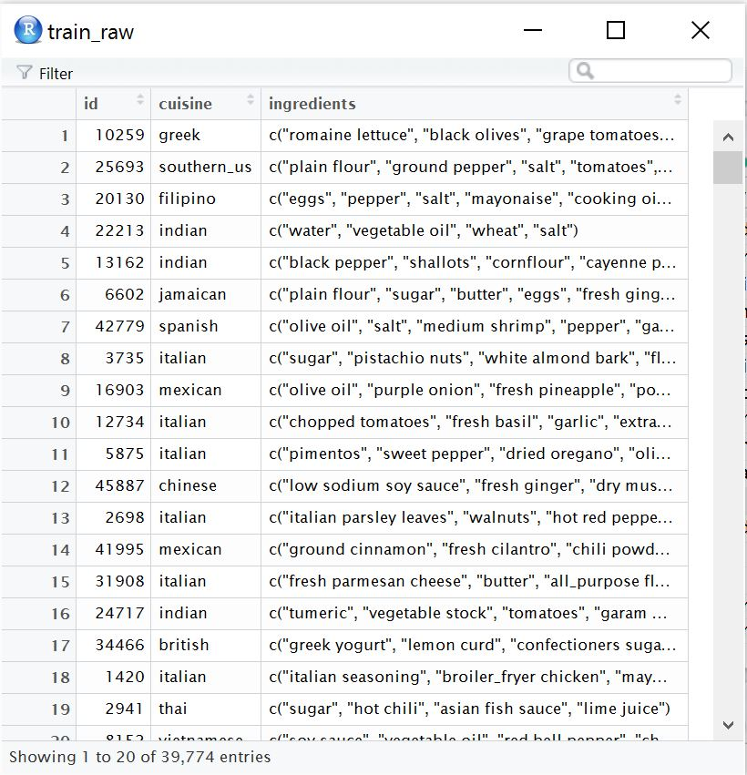
Train_List

Slide 9
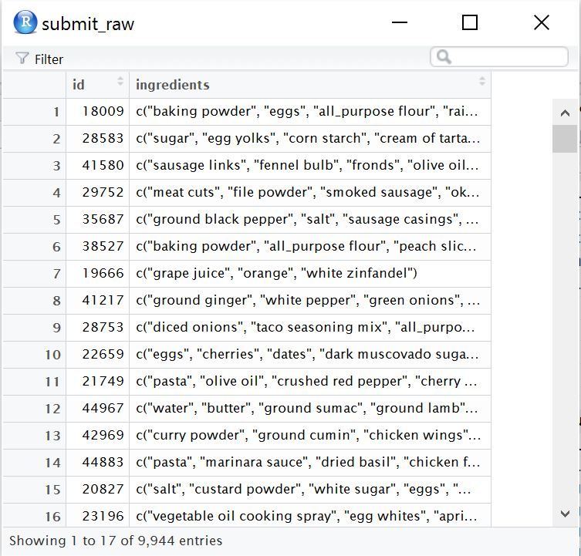
Test_List

Slide 10
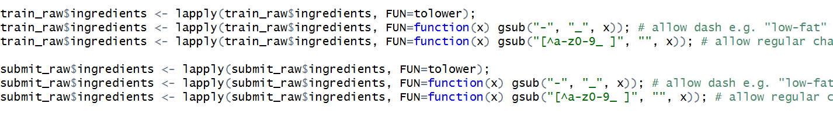
Common Preprocessing
Lower Case Conversion
Remove Punctuations ( But retain Hyphens and Underscores e.g low-fat)
Stemming ( Snowball/Porter)

Slide 11
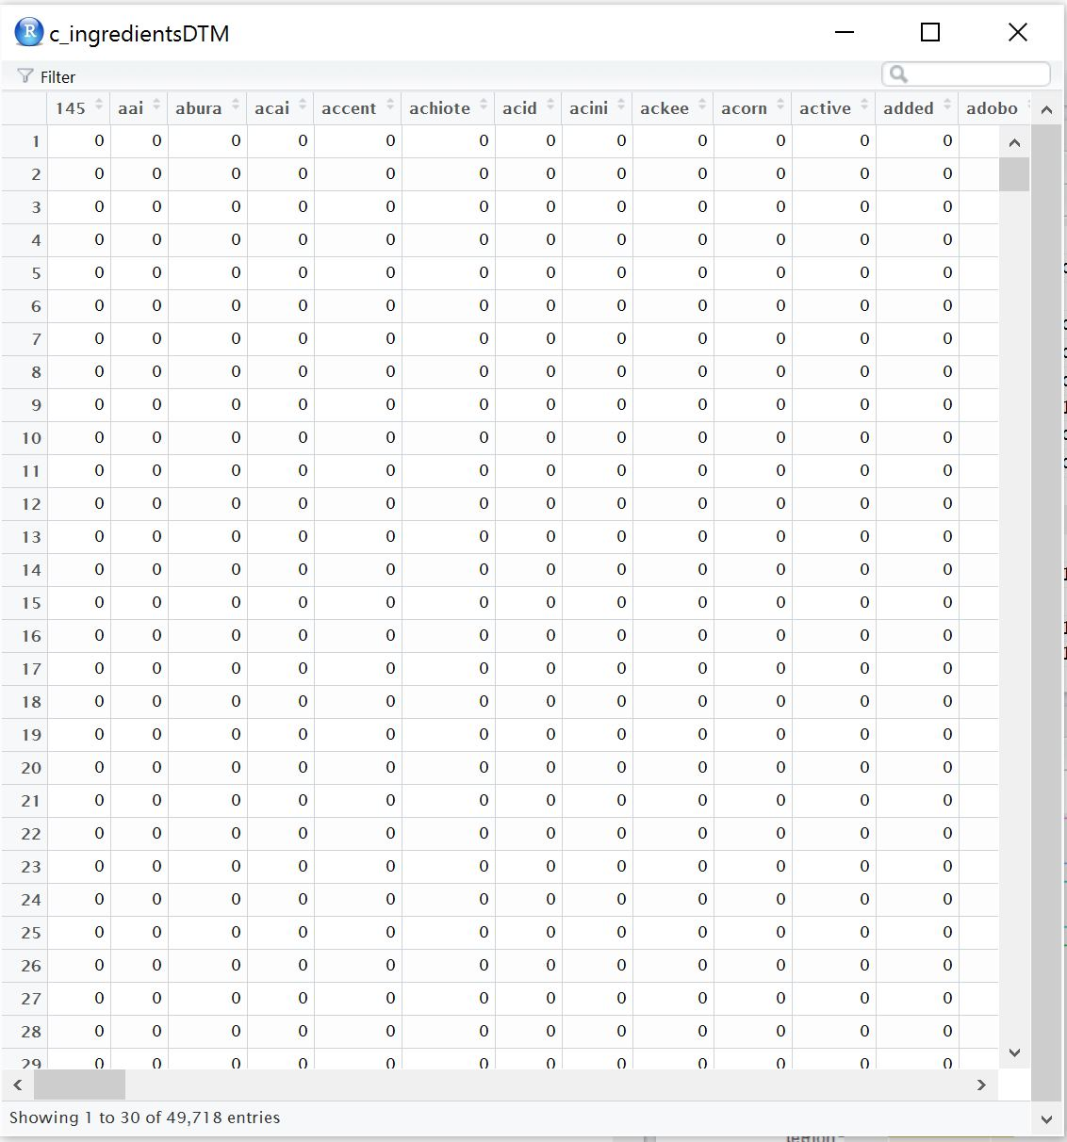
Bag of Ingredients– 49718 records

Slide 12
Create SparseMatrix
Reducing the dimensionality of the matrix by eliminating the least occurring ingredients from the bag of ingredients.
0.99 in the fig. implies that the ingredients should occur in atleast 1% of the dataset (100 – 99 = 1%)

Slide 13

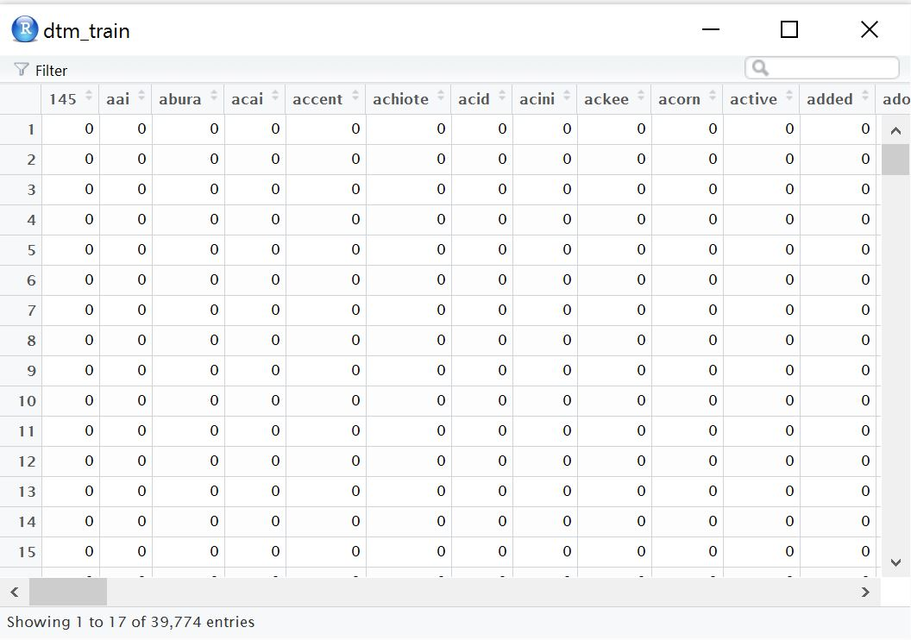
Training Bag of Ingredients Matrix

Slide 14
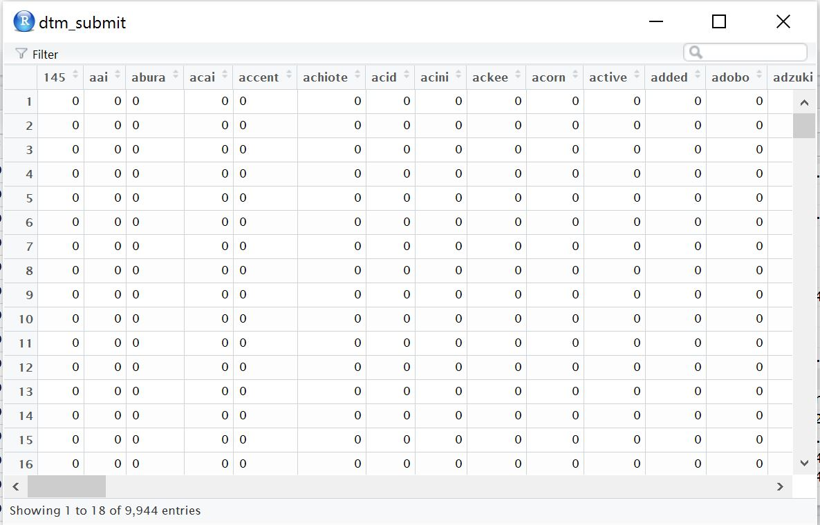
Testing Bag of Ingredients Matrix

Slide 15
RPART (CART)
Classification and regression trees can be generated through the rpart package.
Method:
"class" for a classification tree "anova" for a regression tree

Slide 16
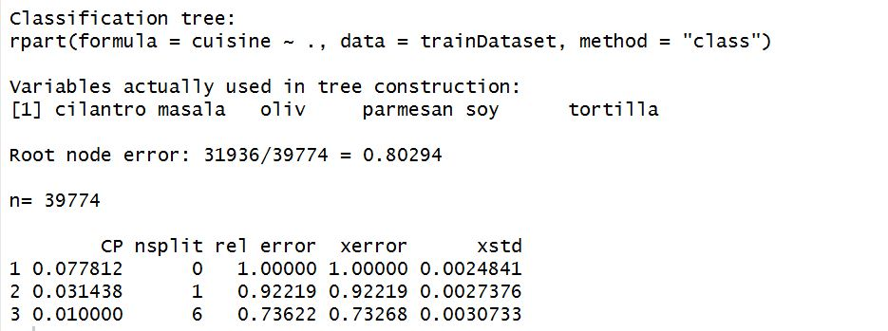
RPART (CART)

Slide 17
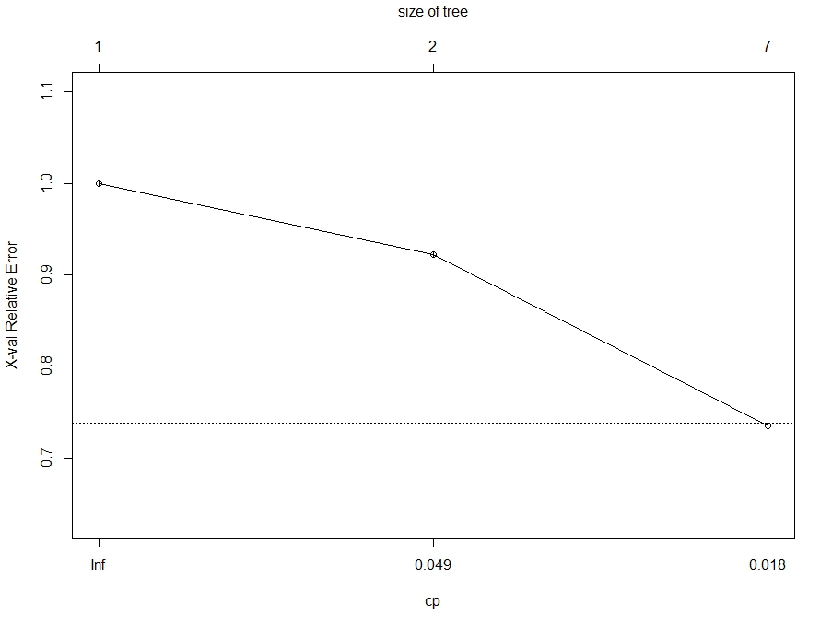

Slide 18
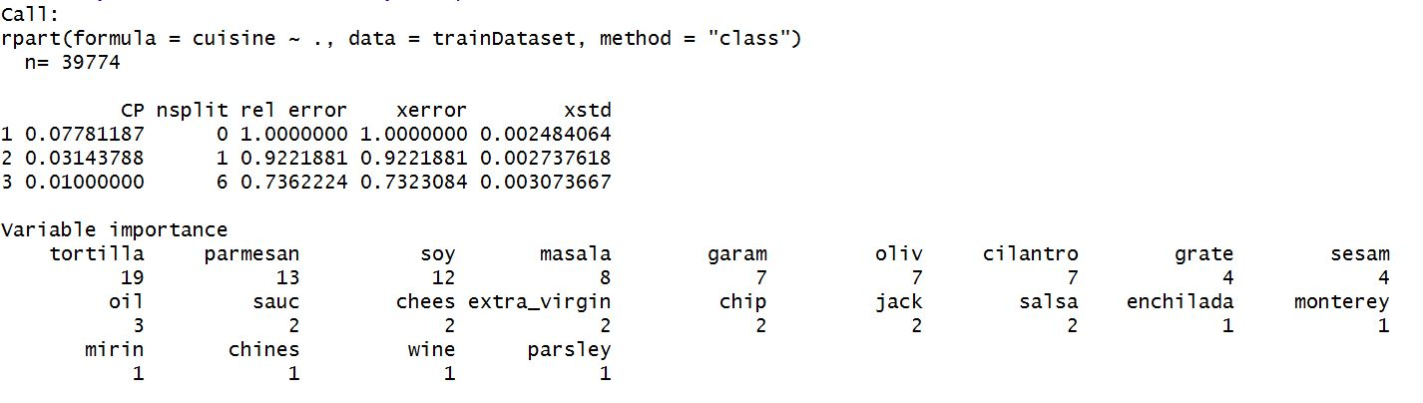
RPART (CART)
Least Cost Complexity factor = 0.01
Number of Splits = 6 (Only 6?)

Slide 19
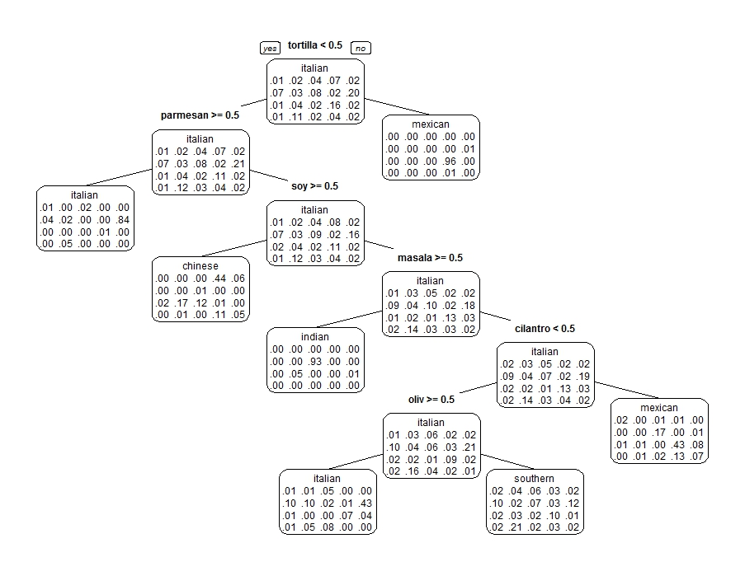

Slide 20
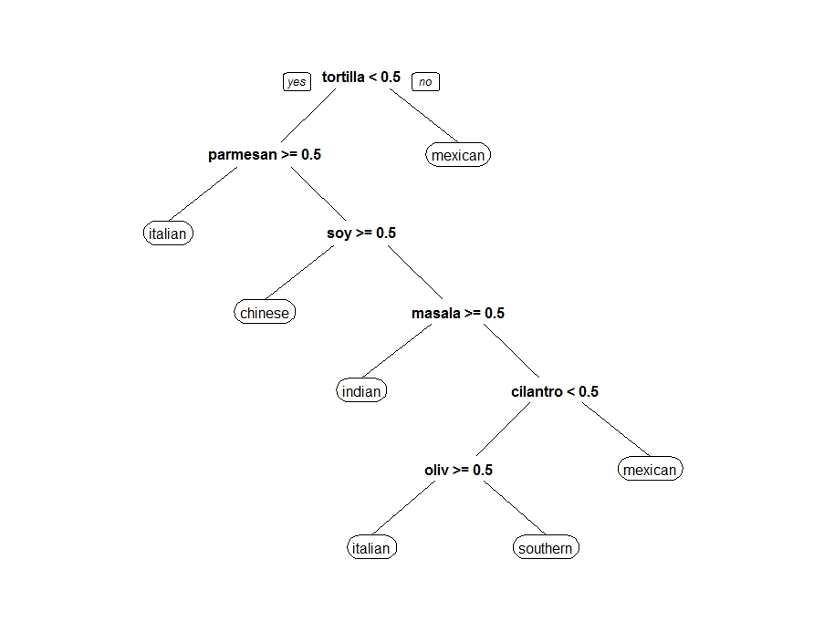

Slide 21
XG Boost
It is short for eXtreme Gradient Boosting.
It is an open Source tool.
Has an interface in R.

Slide 22
Why XG Boost?
Easy to use
Easy to install.
Efficiency
Automatic parallel computation on a single machine.
Accuracy
Good result for most data sets.

Slide 23
Why Softmax?
When More than 2 classes present in the dataset,
multi: softmax is used.
It is a regression technique that uses an iterative
Algorithm to estimate the parameters of the model.
Competitive in terms of CPU and memory consumption.

Slide 24
Xgboost and parameters

Slide 25
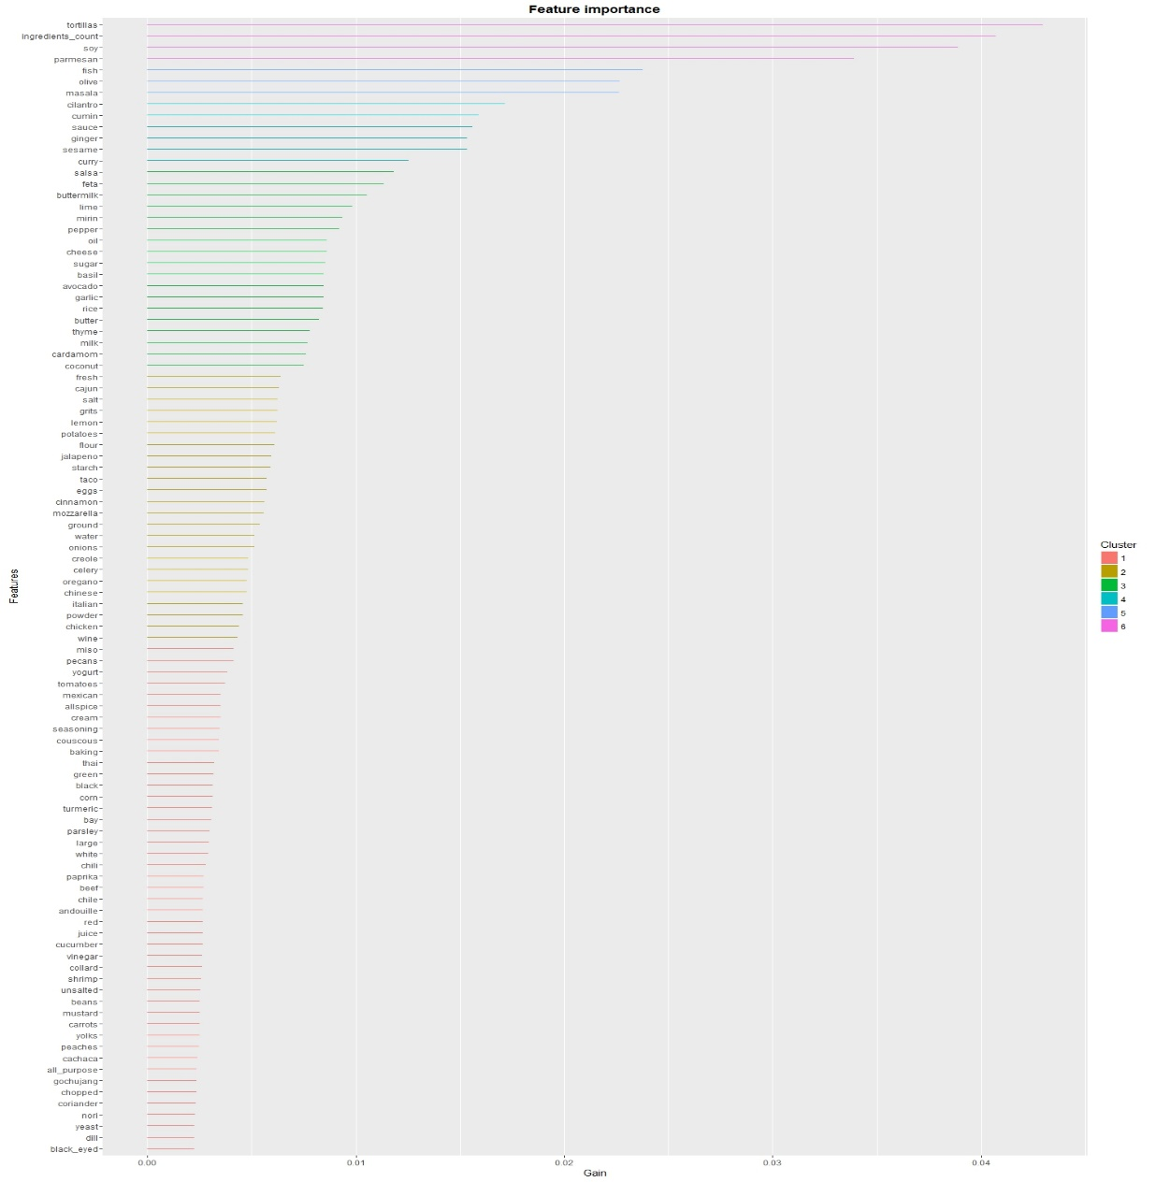

Slide 26
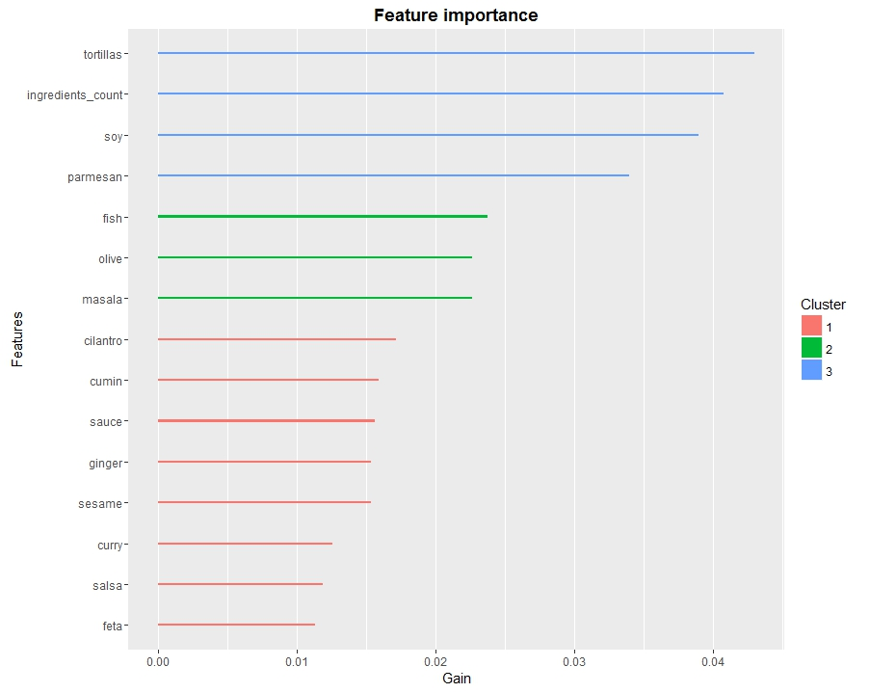

Slide 27
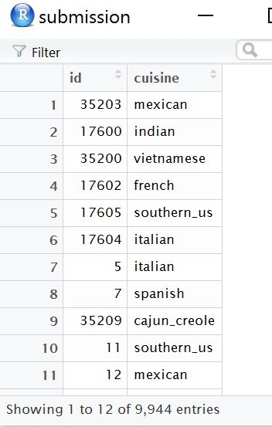

Slide 28
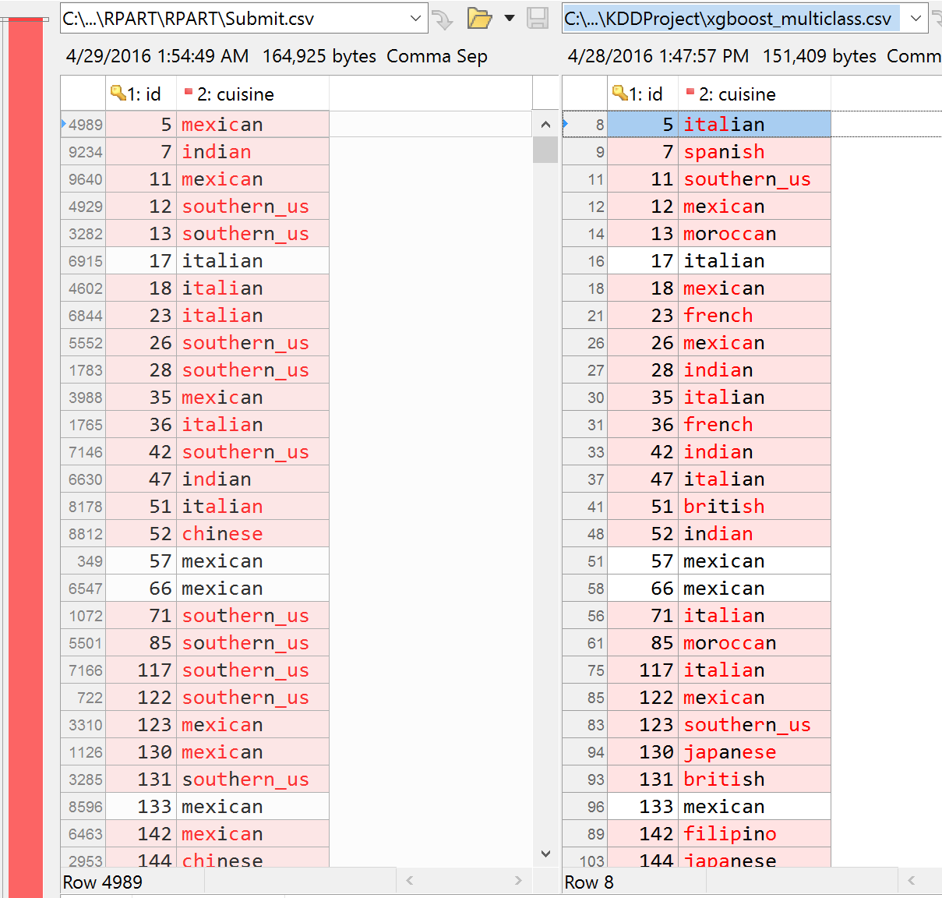
CART
~43% Accurate
Xgboost:Softmax
~81% Accurate

